Slide 1
Use of The Part 2 App for Item Independence
Questions or issues can be sent to David Schreurs at schreurd@uwm.edu

Slide 2
Overview
Part 1 (Different App):
Runs Differential Item Functioning (DIF) through various methods to help establish good questions which will later be used as anchors between the assessments
Part 2 (This App):
Based on the anchor items selected from Part 1 and a qualitative analysis of the items, this app will run anchored IRT.

Slide 3
Notes Before Running the App
Installation of BILOG-MG is required if the use of its algorithm is desired. If BILOG-MG installation was completed with the default options no further action should be required to use this feature. If BILOG-MG is not saved in the default location, you will have the option to specify the folder which contains the following three required files: blm1.exe, blm2.exe, and blm3.exe. Without BILOG-MG, the app can still be used with R’s “ltm” engine.
BILOG functionality is possible because R writes the necessary BILOG code files and then runs that code in the background. This means that running multiple instances of the app simultaneously may result in file conflicts leading to unexpected errors.

Slide 4
Table of Contents
Preparing Data
Running the App
Using the App
Interpreting Exported Results

Slide 5
Data
Before this app can be used the raw data needs to be prepared. This app allows you to import data saved as an excel document (.xlsx).
The first excel document should include
1 column for each question wishing to be compared between two tests
1 column for “grouping” indicating which assessment the student took
1 row for each student who complete data is available for
Note
Besides headings, all cells must be either a 0 or a 1. No other values or empty cells are permitted! This means the tests have to be compared in independent pairs (e.g. Test 1:Test 2, Test 1: Test 3, Test 2: Test 3)

Slide 6
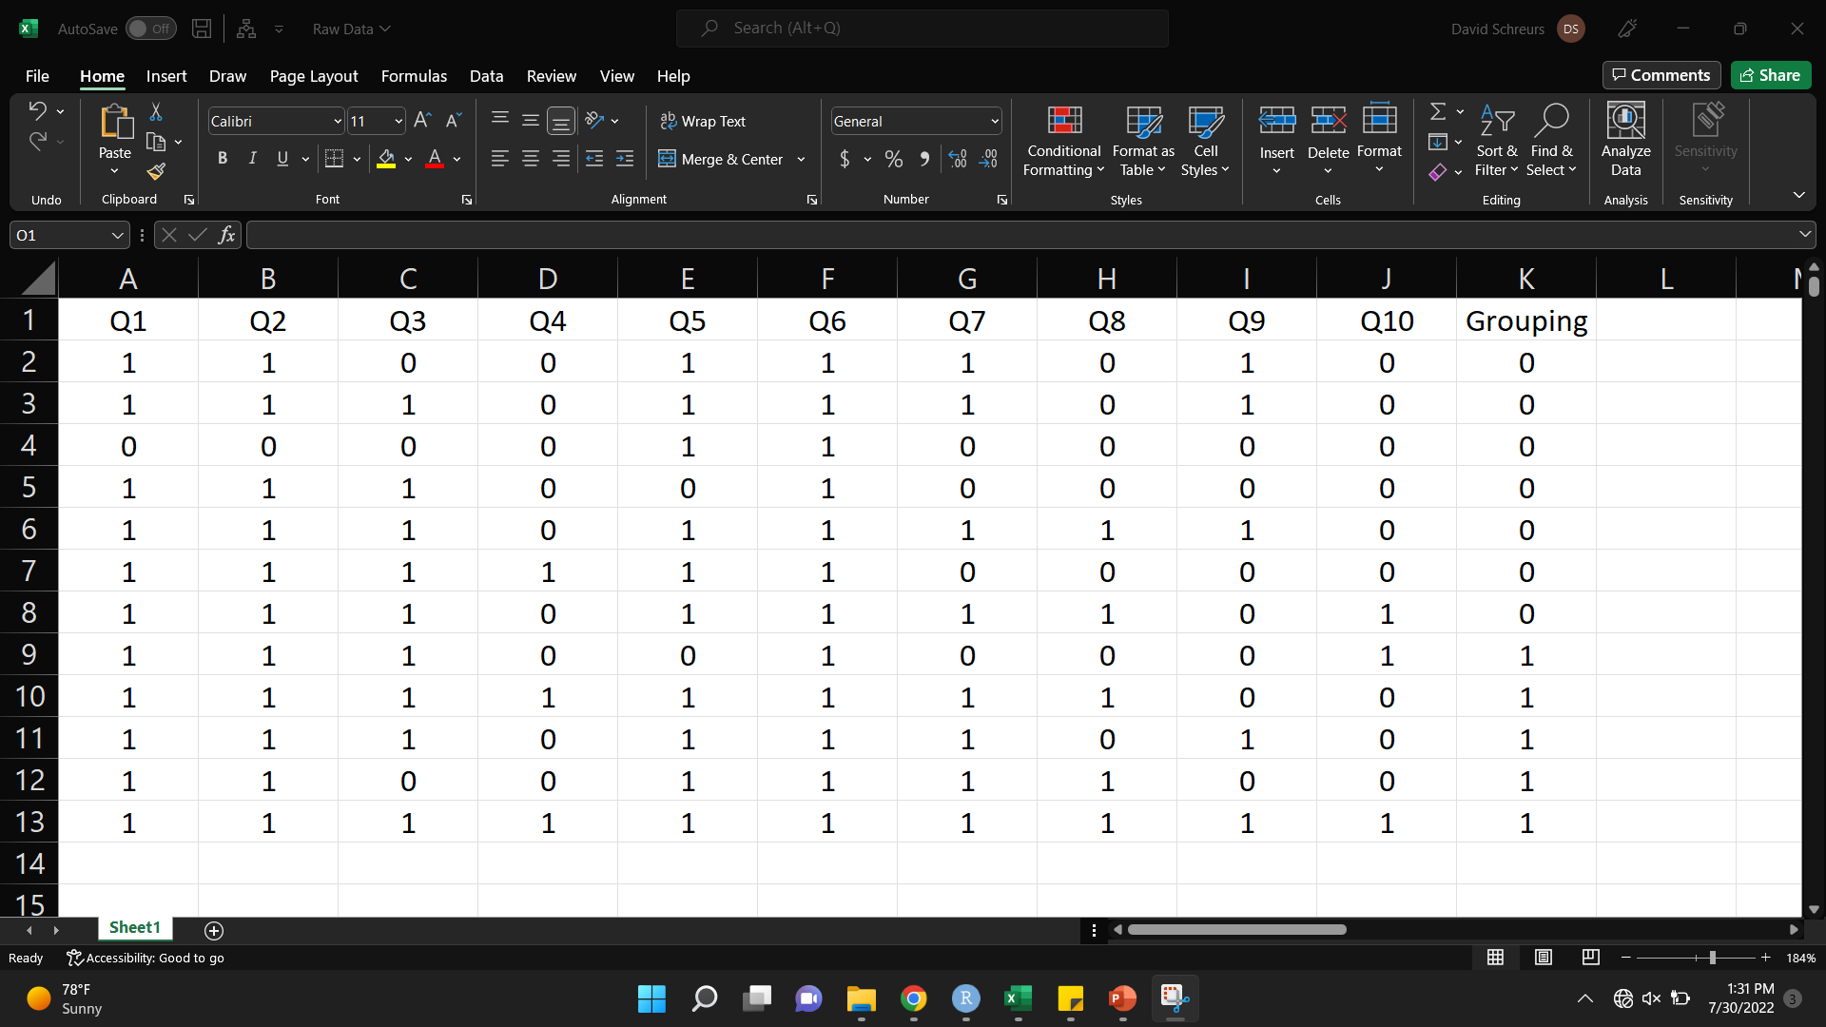
Example Data
Grouping (Which Test)
Questions
Student Data
0: Incorrect
1: Correct

Slide 7
Data Continued
The second document that must be prepared contains the anchoring information
The second excel document should include in this order
1 column of the questions wishing to be anchored. These must match the column headings from the first document exactly.
1 column for the anchoring discriminations
1 column for the anchoring difficulties
Note
The first row is expected to be headings. These can be whatever you wish but some heading is required.

Slide 8
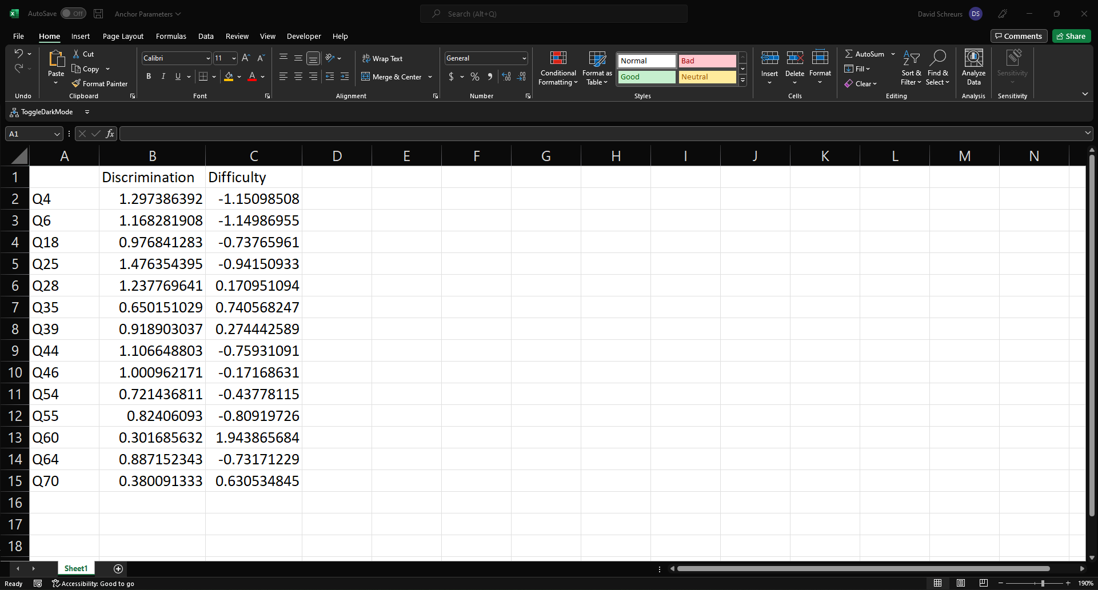
Example Data 2
Discrimination First
Difficulty Second
Question Headings Matching Document 1
Bonus Feature: If question heading listed here is not in the other data file it will simply be ignored. This means this document only has to be created once and can be reused for all pair-wise comparisons.

Slide 9
Running The App
Prior to opening the app, if this is the first time running the app on this computer, install the necessary packages by running these lines of code in the R console
install.packages("shiny")
install.packages("DT")
install.packages("shinyjs")
install.packages("ggplot2")
install.packages("readxl")
install.packages("irtoys")
install.packages("openxlsx")
install.packages("difR")
install.packages("subscore")
install.packages("shinydisconnect")
install.packages("irt")
install.packages("dplyr")
install.packages("shinyFiles")

Slide 10
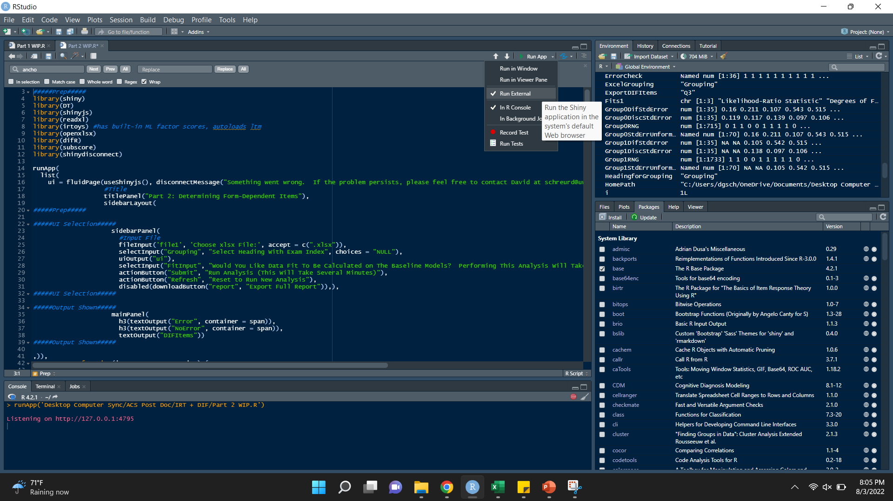
Running The App
Open the file in R Studio
In the upper right ensure “Run External” is checked as shown here
Then click “Run App”

Slide 11
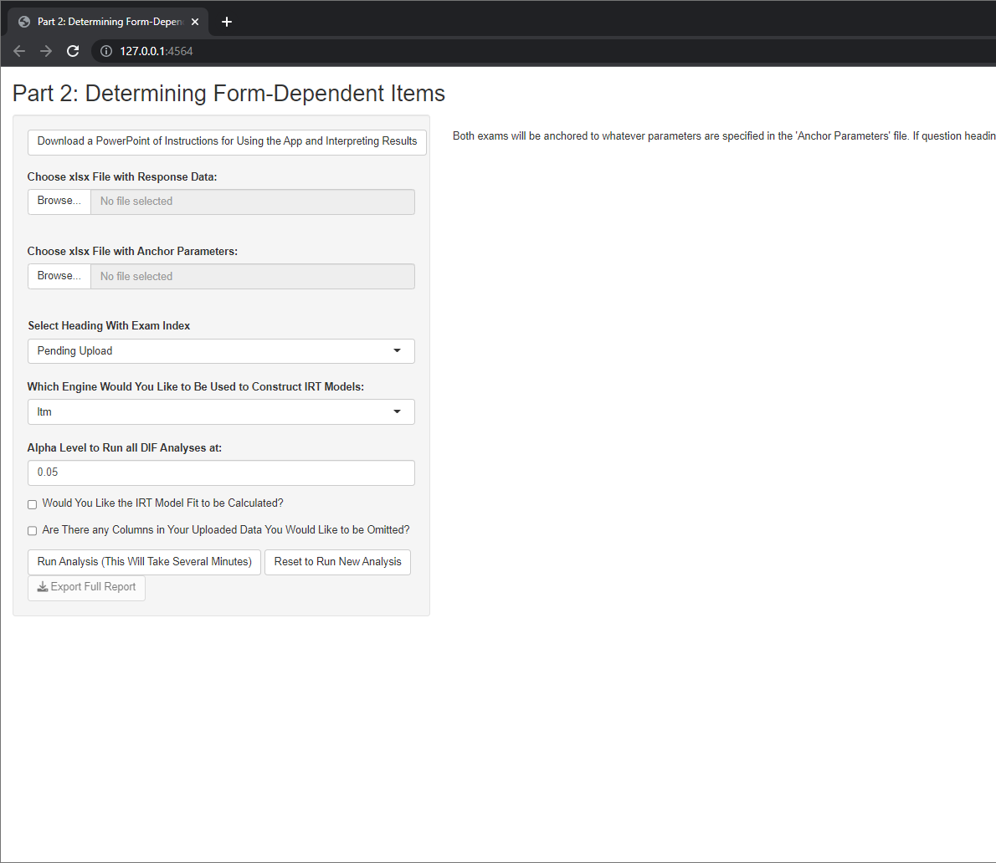
Using the App
Step 0: This button will allow you to download this PowerPoint document should you ever lose this copy or require instructions for future versions.

Slide 12
Using the App
Step 1: Click “Browse” which will prompt you to select the first excel file you prepared during the previous slides (containing student-level response data)

Slide 13
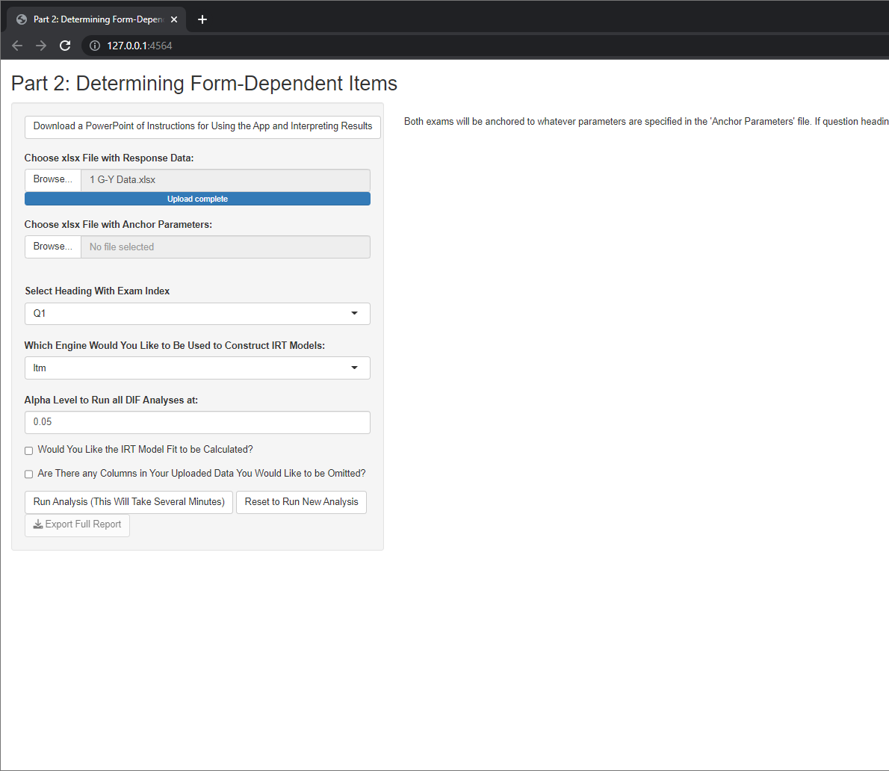
Using the App
Step 2: Click “Browse” which will prompt you to select the second excel file you prepared during the previous slides (containing anchor items and parameters)

Slide 14
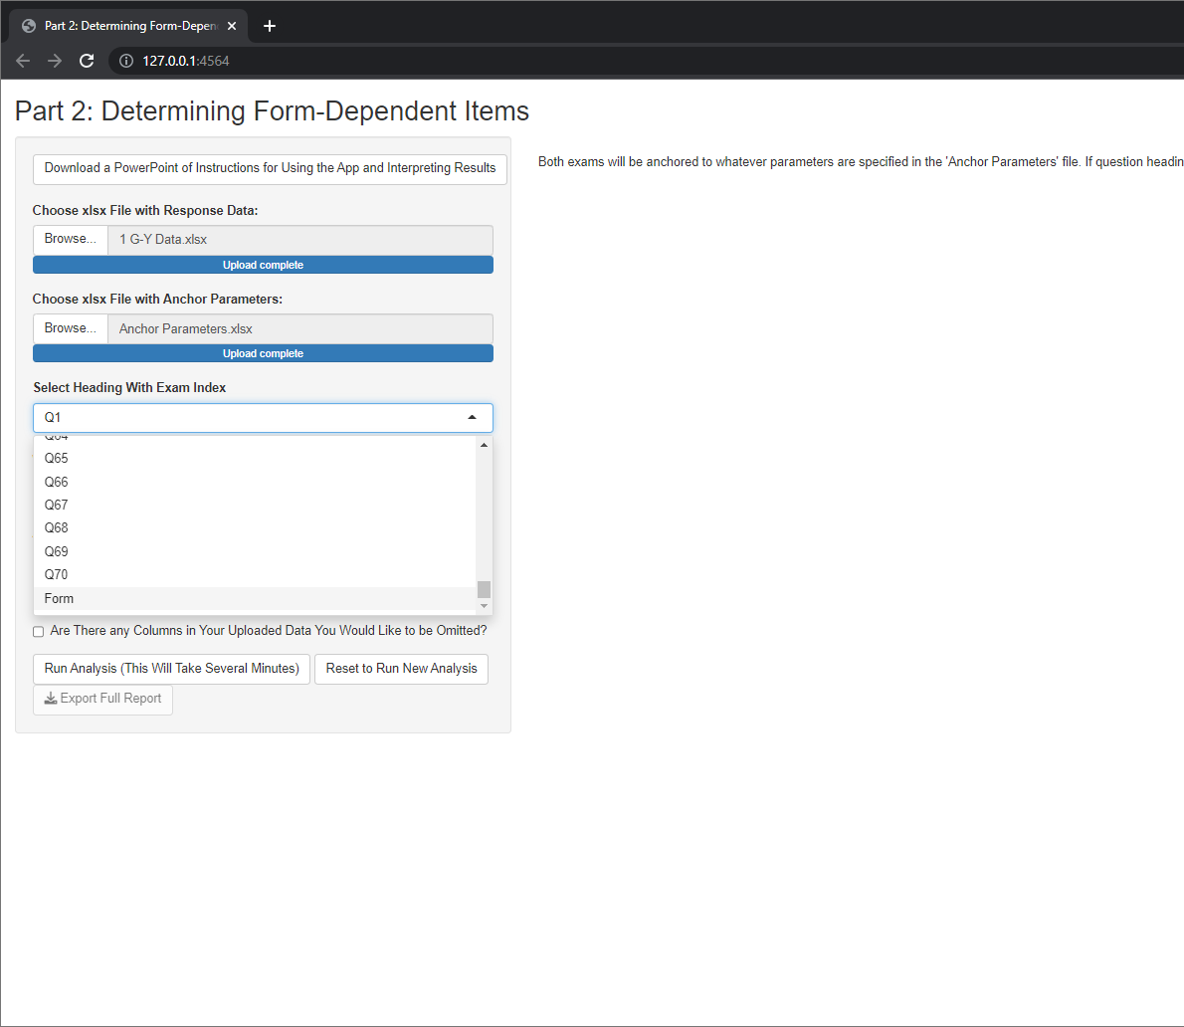
Using the App
Step 3: After file upload, this dropdown menu will be updated to provide the headings from the first excel document. Select the heading corresponding to the column of data specifying the test the data was from. In this case, I named this column “Form”

Slide 15
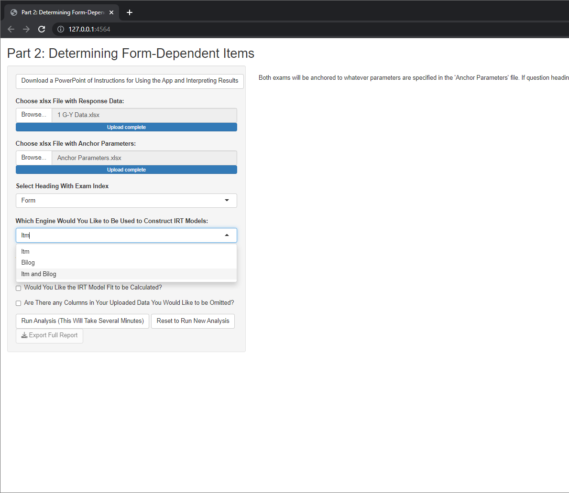
Using the App
Step 4: This dropdown allows you to specify which engine you would like to use for generating IRT parameters and fits. ltm is a package native to R which uses an empirical bayes algorithm, Bilog requires the installation of Bilog-MG which uses a maximum likelihood algorithm. If “ltm and Bilog” is selected, each engine will be used independently with the results from each being exported.

Slide 16
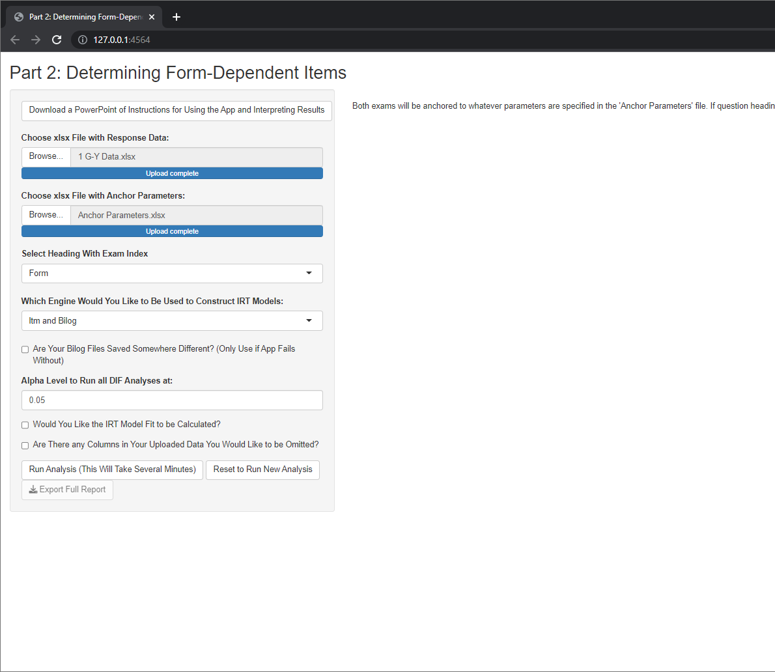
Using the App
Skip this step if you have the default Bilog installation
Step 5A: If Bilog is to be used, R needs access to the Bilog installation. By default, R will look in Bilogs default installation location (C:/Program Files/BILOGMG). If the files are saved elsewhere, check this box. If you are not sure, you can run the analysis with this unchecked and if R cannot find the needed files it will stop and tell you.

Slide 17
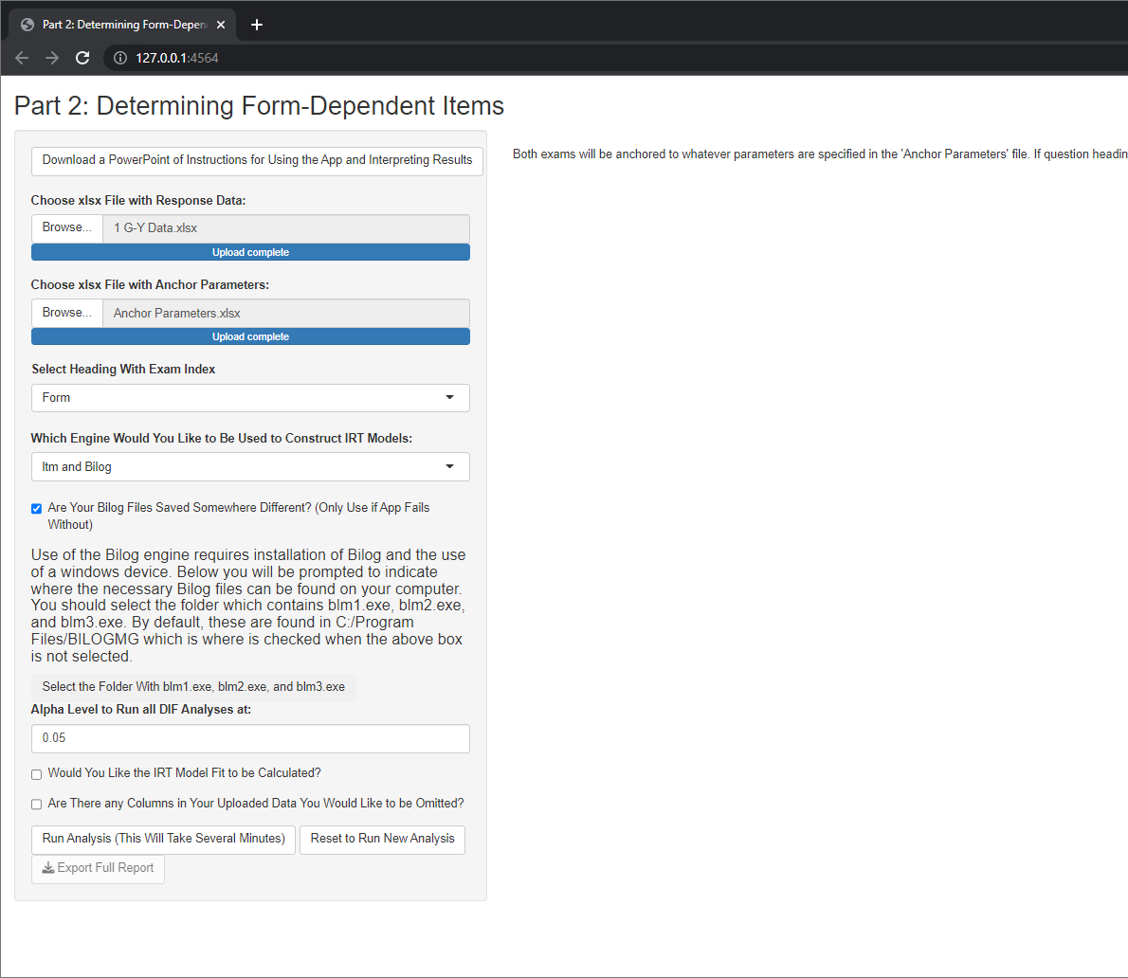
Using the App
Skip this step if you have the default Bilog installation
Step 5B: If your Bilog installation is saved elsewhere, a new button will appear where you can specify which folder contains the needed files.

Slide 18
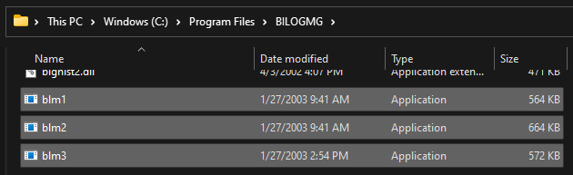
Using the App
Skip this step if you have the default Bilog installation
Step 5C: If your Bilog installation is saved elsewhere, go to your file explorer and find the path to the three needed files: blm1.exe, blm2.exe, and blm3.exe. Here you can see my installation is in the default location (C:/Program Files/BILOGMG).

Slide 19
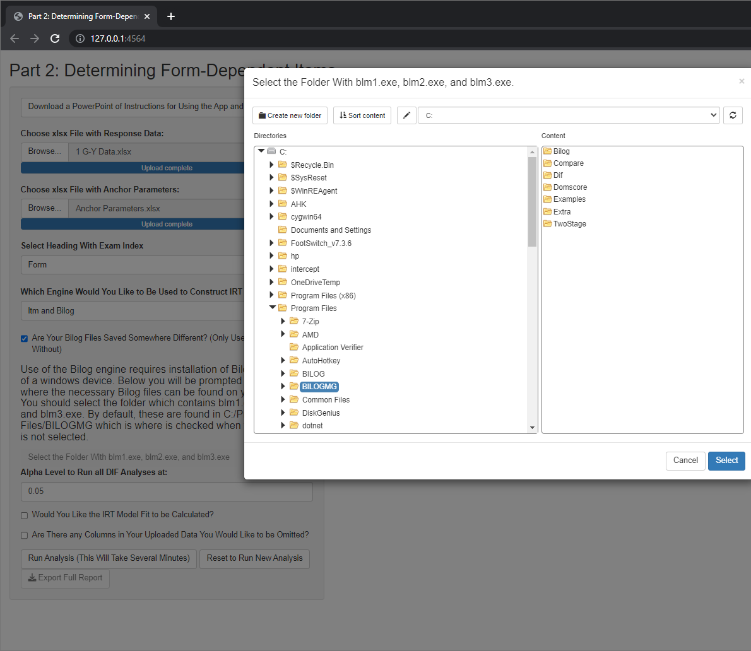
Using the App
Skip this step if you have the default Bilog installation
Step 5D: After you know where the needed files are located, return to R. After clicking the button to select the needed folder, a popup window will appear where you should select the folder where the files can be found.

Slide 20
Using the App
Step 6: Input an alpha level for Lords d to test for DIF at. This defaults at 0.05.

Slide 21

Using the App
Step 7: Select if you would like the IRT model fit statistics to be calculated. The model fits will take considerably longer to calculate.

Slide 22
Using the App
Step 8A: This final option should be selected if your dataset includes any columns besides the relevant question-level data and the grouping column used to specify the exam (e.g. student identifiers, student sex, undesired questions, ext).

Slide 23
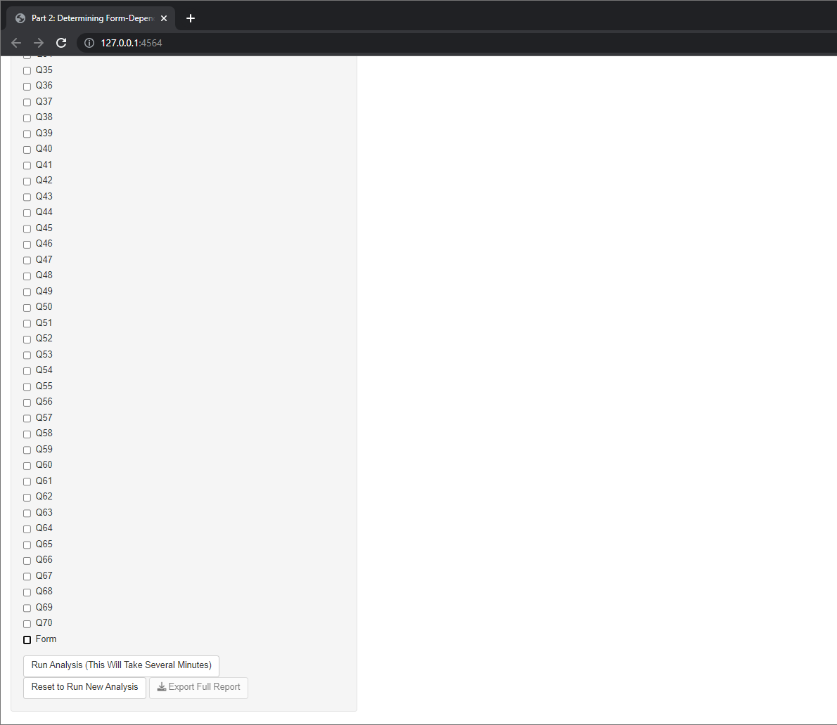
Using the App
Step 8B: If you indicated there are columns of data to be omitted, this new selection will pop-up with all of the column headings of your document. Select all columns that do not include the relevant data.
Side note: Your grouping column can be selected or left unselected

Slide 24
Using the App
Step 9: Click “Run Analysis (This Will Take Several Minutes)” to generate preliminary results.

Slide 25
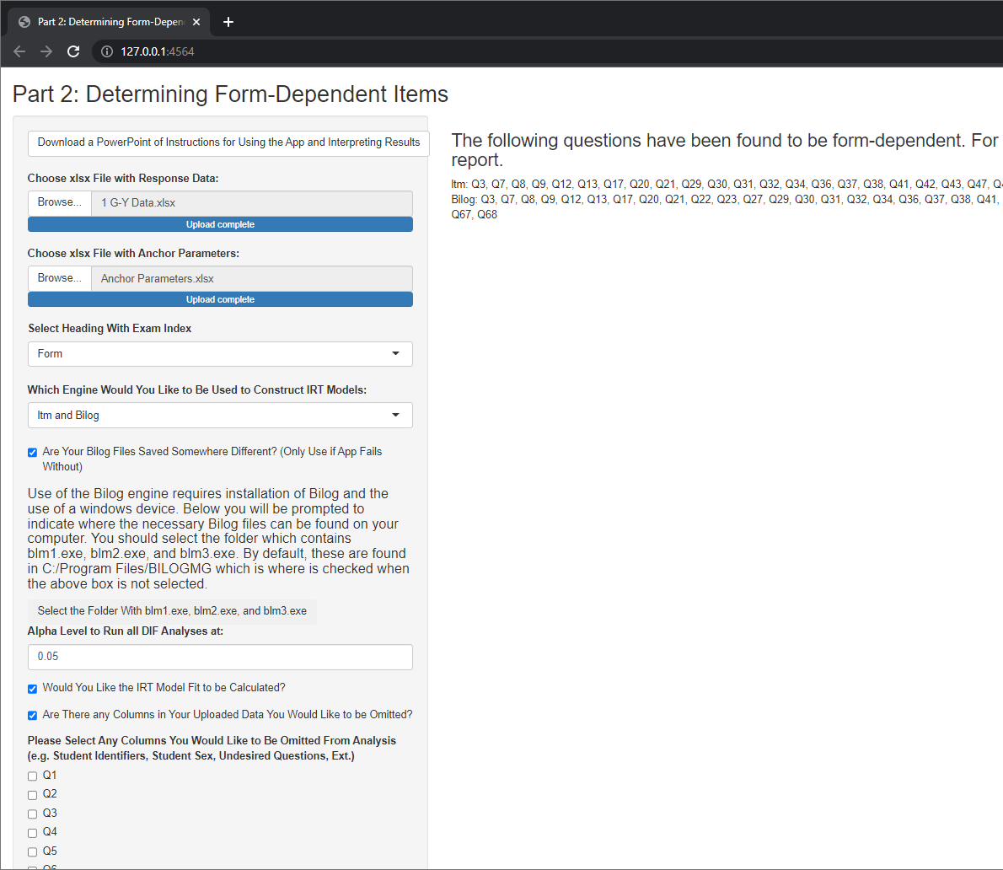
App Results
The right of the page will show which questions were found to be form dependent based on the value of Lord’s d. These are the items found to differ in difficulty, discrimination, or both. If both engines were used, the results for each will be shown.

Slide 26
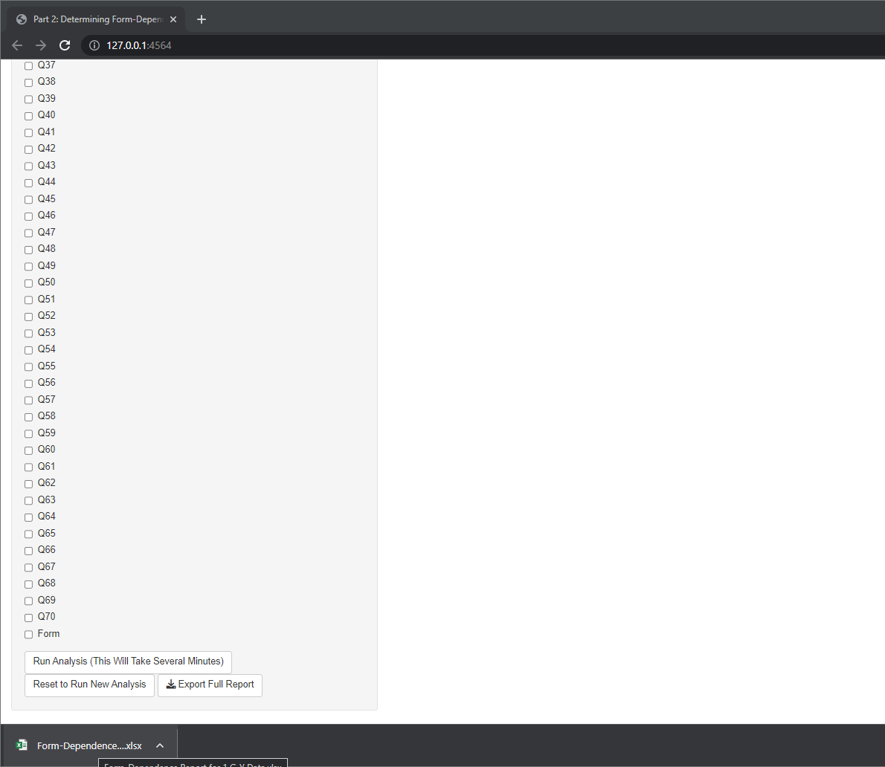
App Full Results
To get quantitative values, click “Export Full Report”. This will export the preview shown on the page, the IRT parameters from each model, lord’s d values, and the IRT model fits (if “Calculate Fit” was selected). After the report is generated, a file will be downloaded. In chrome, this will appear on the bottom of the screen as well as in the computers “Downloads” folder. The file is named “Form-Dependence for…” prior to the name of the file selected for analysis. Since my data file was named “1 G-Y Data.xlsx”, my downloaded file is named “Form-Dependence for 1 G-Y Data.xlsx”

Slide 27
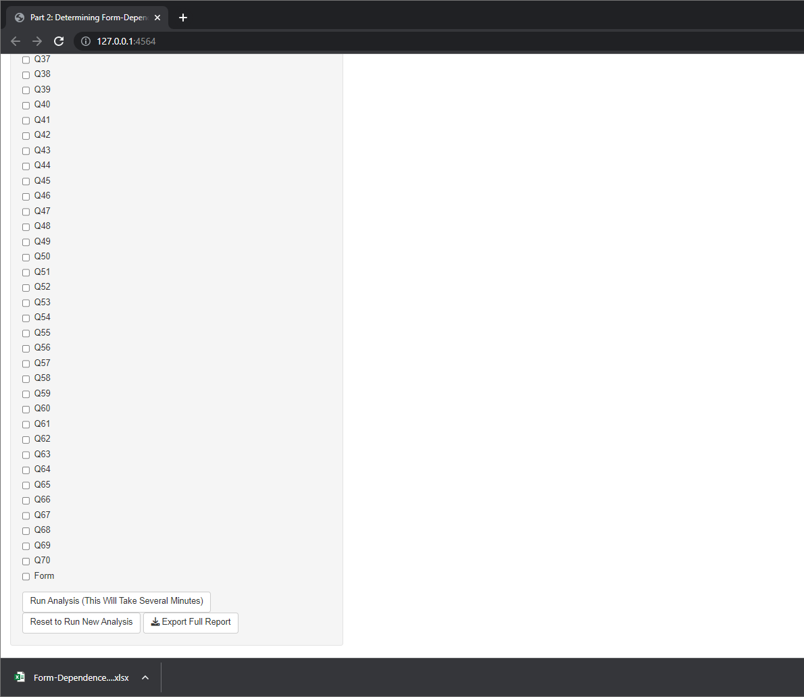
App Reset
To run a different analysis, you can either exit and relaunch the app or press the “Reset to Run New Analysis” button.

Slide 28
Interpreting Exported Results
The downloaded document should be an excel document which contains several tabs of data.
File Summary
Form-Dep Items
Group 0 Anchored IRT Par
Group 1 Anchored IRT Par
IRT Parameter Plots
Lord's d Results
Factor Scores
IRT Model Fit (*If Selected)

Slide 29
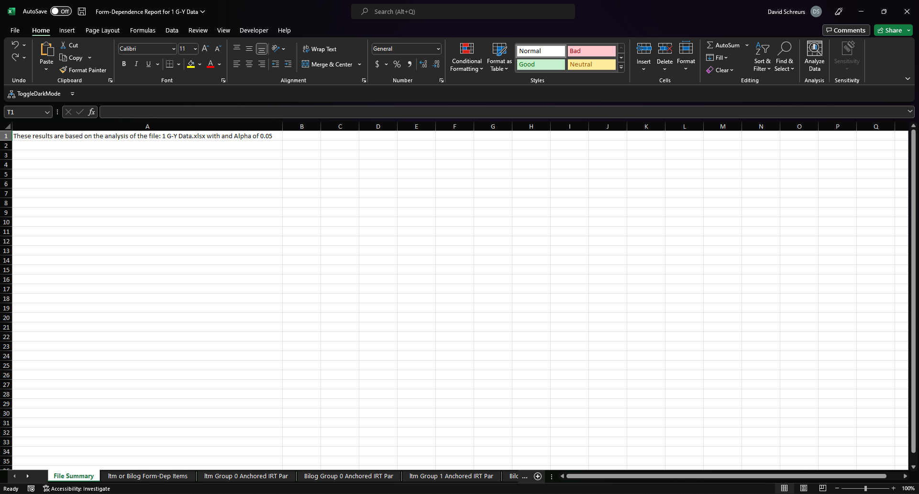
1. File Summary
A reminder of what data and what alpha value this analysis corresponds to.

Slide 30
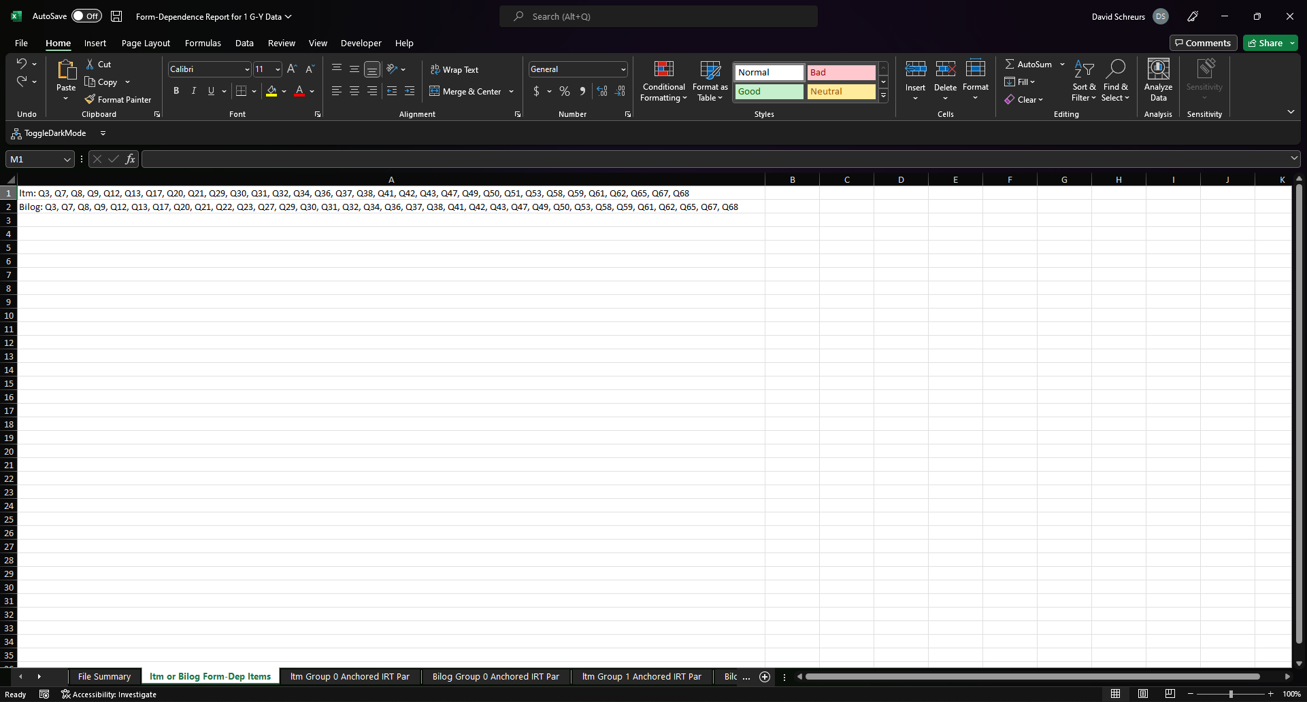
2. Form-Dep Items
Items which were found to be form dependent based on the alpha level and engine(s) selected. These are items which differed by difficulty and/or discrimination

Slide 31
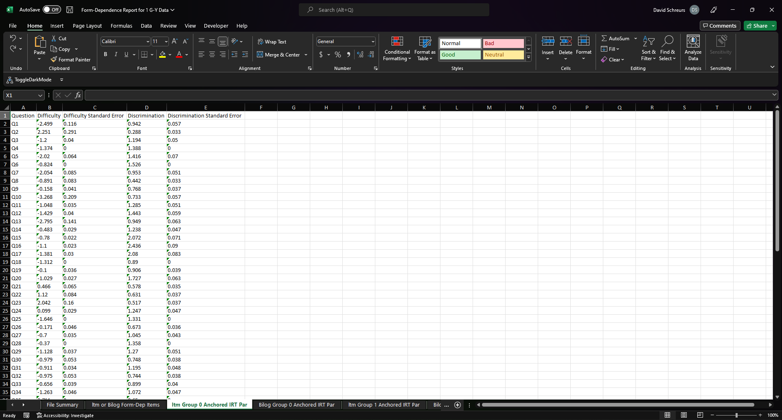
3. Group 0 Anchored IRT Par
IRT parameters for the group coded as “0”. Questions with standard errors equal to 0 are the items which were used as anchors.
Which IRT engine you selected will determine which of these tabs (or both) will be present

Slide 32
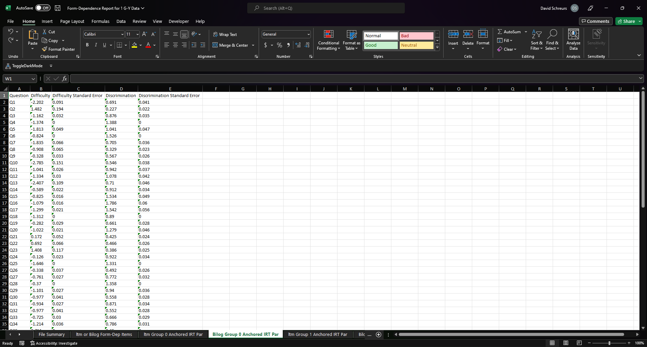
3. Group 0 Anchored IRT Par
IRT parameters for the group coded as “0”. Questions with standard errors equal to 0 are the items which were used as anchors.
Which IRT engine you selected will determine which of these tabs (or both) will be present

Slide 33
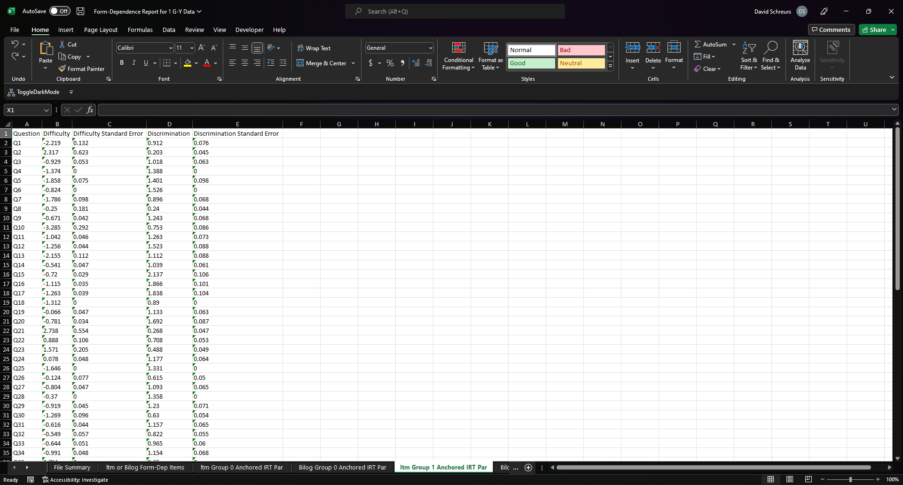
4. Group 1 Anchored IRT Par
IRT parameters for the group coded as “1”. Questions with standard errors equal to 0 are the items which were used as anchors.
Which IRT engine you selected will determine which of these tabs (or both) will be present

Slide 34
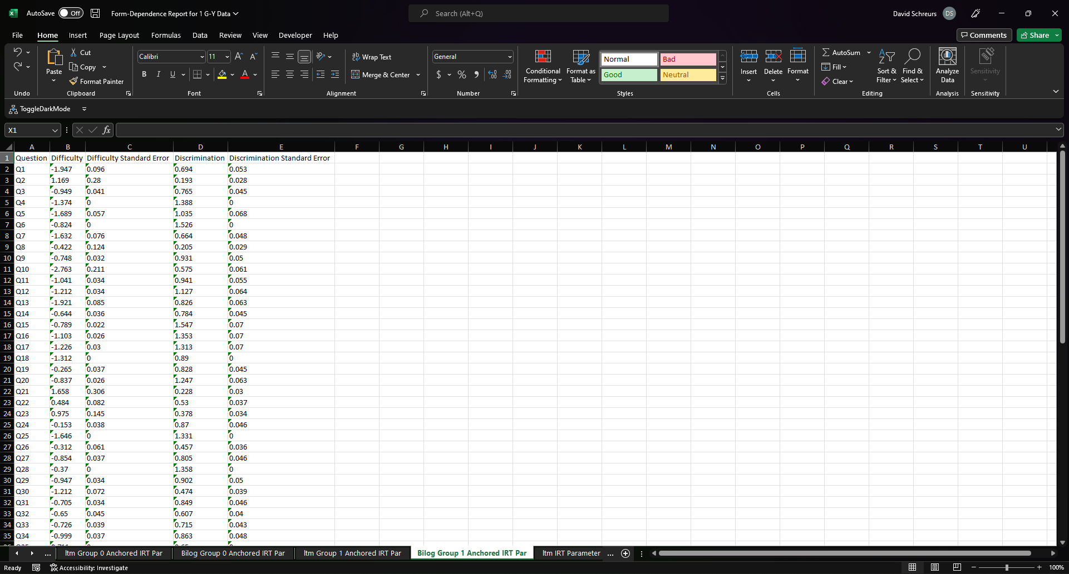
4. Group 1 Anchored IRT Par
IRT parameters for the group coded as “1”. Questions with standard errors equal to 0 are the items which were used as anchors.
Which IRT engine you selected will determine which of these tabs (or both) will be present

Slide 35
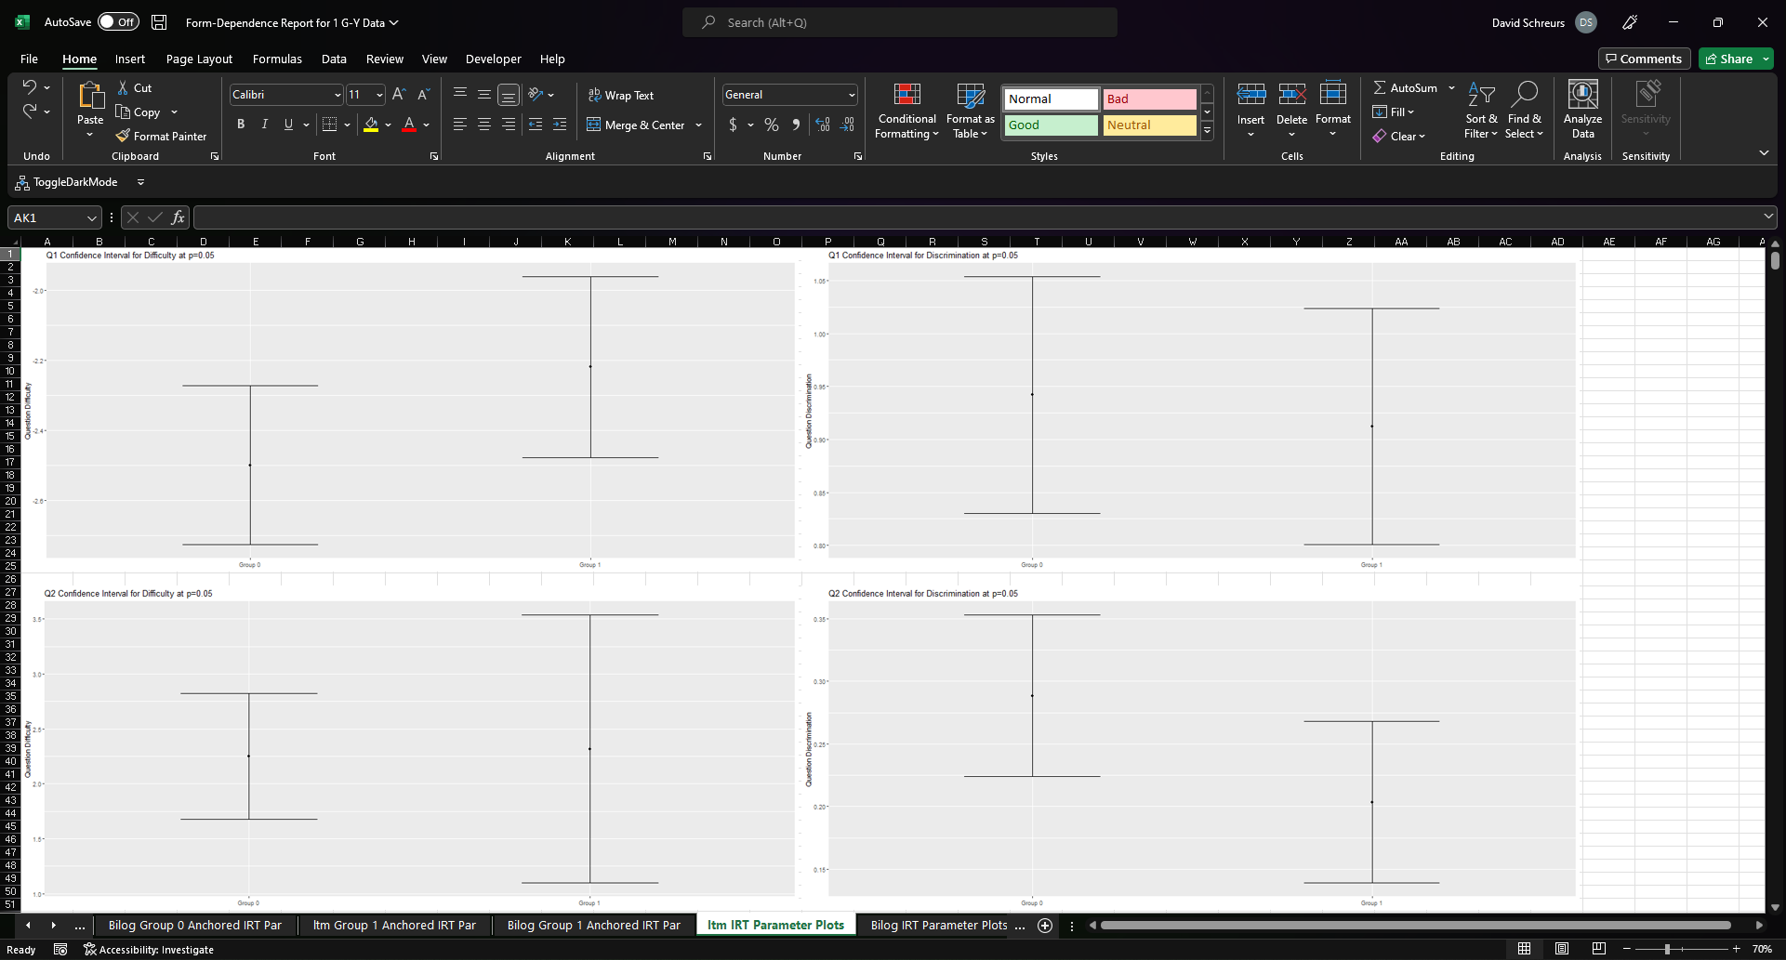
5. IRT Parameter Plots
This tab is only included for consistency with the paper written by Tom. These should not be used for determining significance as comparing two confidence intervals does not correctly account for error. Use significance values and Lord’s d instead.
Which IRT engine you selected will determine which of these tabs (or both) will be present

Slide 36
5. IRT Parameter Plots
The confidence interval of IRT parameters comparing each exam. Confidence intervals are based on the alpha specified so in this example these are 95% confidence intervals because I set alpha to 0.05.
Which IRT engine you selected will determine which of these tabs (or both) will be present

Slide 37
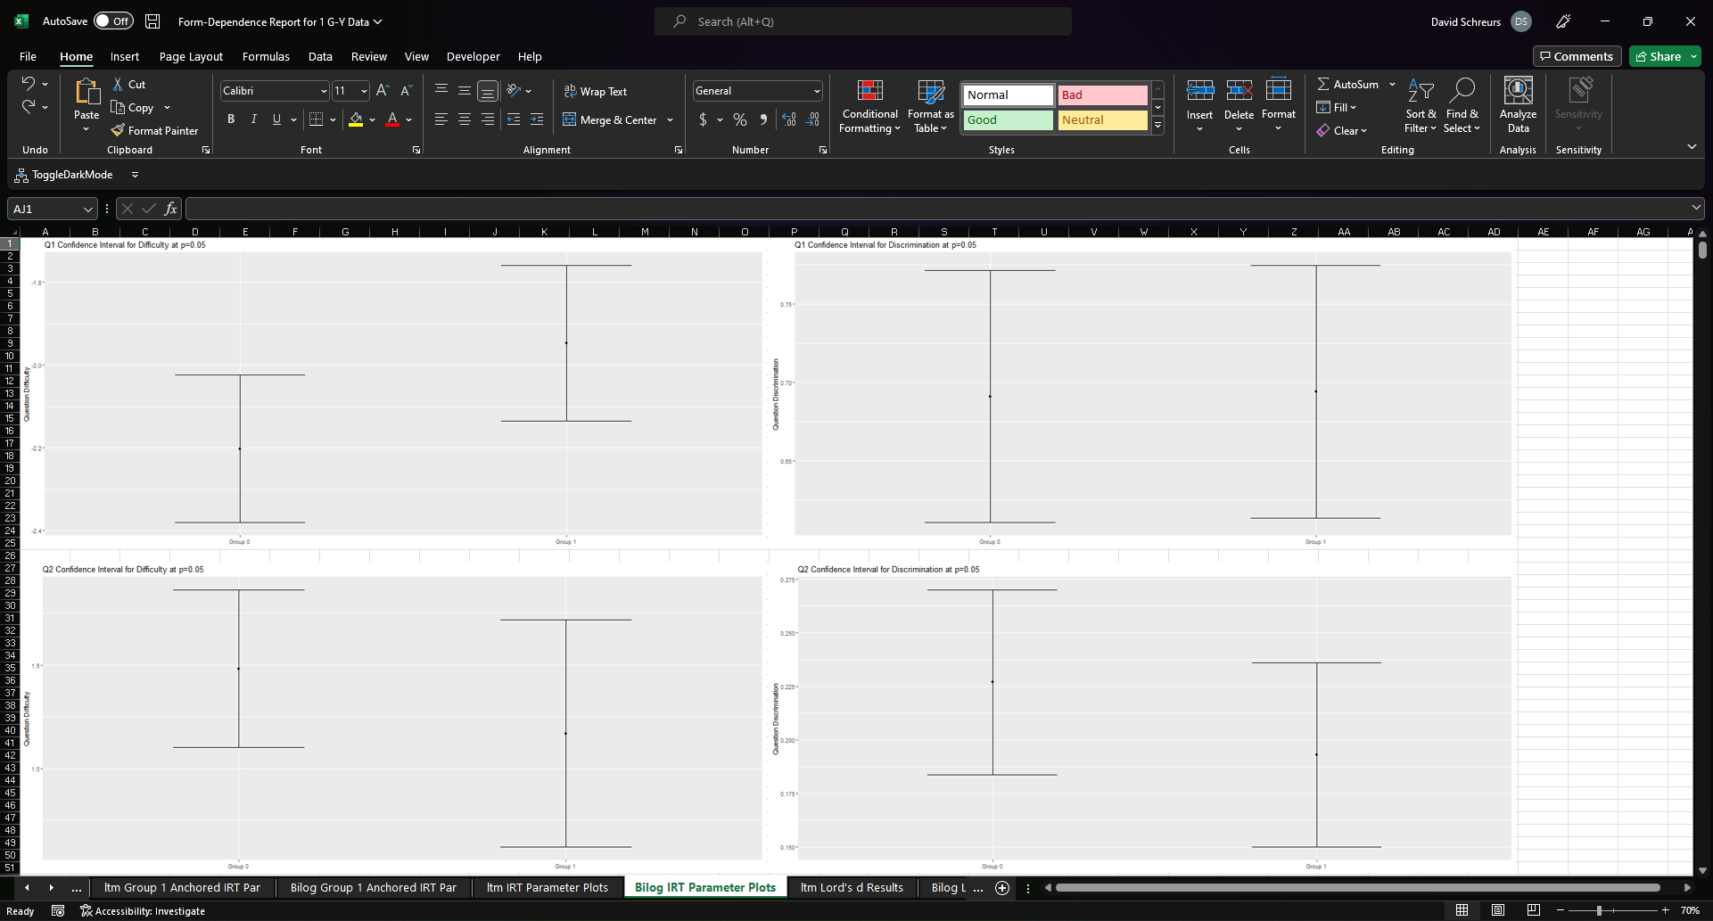
5. IRT Parameter Plots
The confidence interval of IRT parameters comparing each exam. Confidence intervals are based on the alpha specified so in this example these are 95% confidence intervals because I set alpha to 0.05.
Which IRT engine you selected will determine which of these tabs (or both) will be present

Slide 38
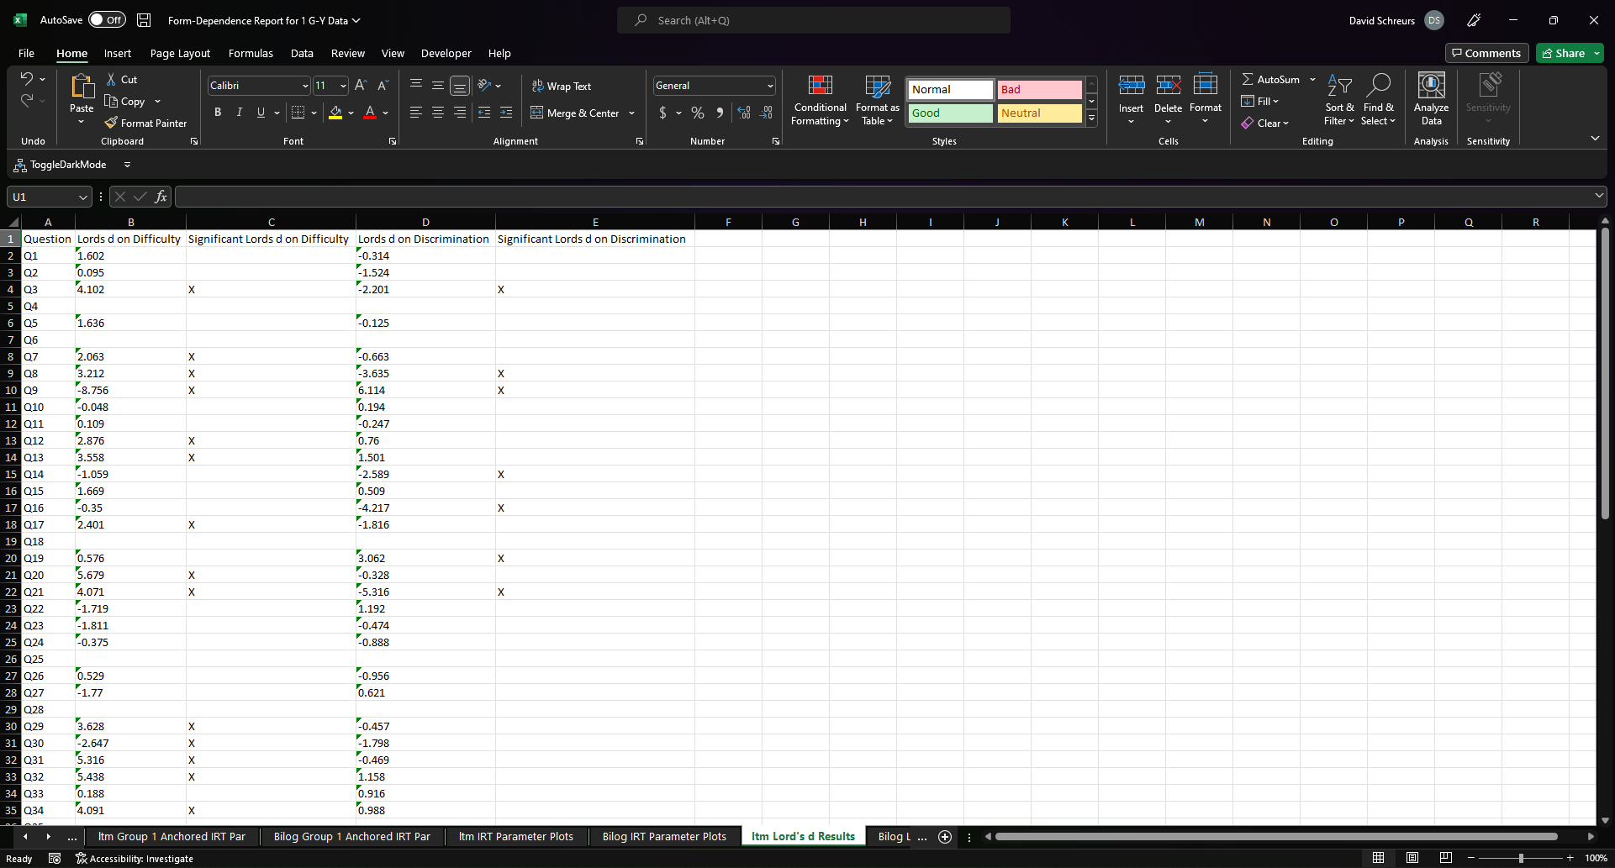
6. Lord's d Results
The value of Lord’s d for each question and parameter. An “X” indicates the question exceeded the critical value at the specified alpha.
Which IRT engine you selected will determine which of these tabs (or both) will be present

Slide 39
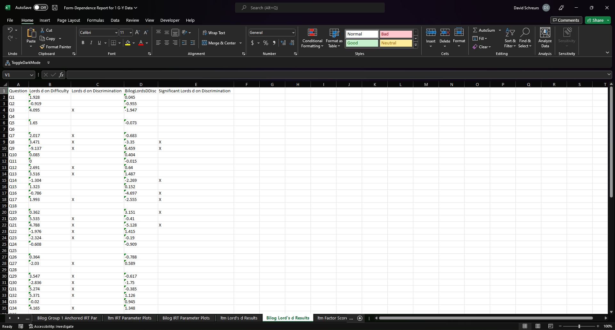
6. Lord's d Results
The value of Lord’s d for each question and parameter. An “X” indicates the question exceeded the critical value at the specified alpha.
Which IRT engine you selected will determine which of these tabs (or both) will be present

Slide 40
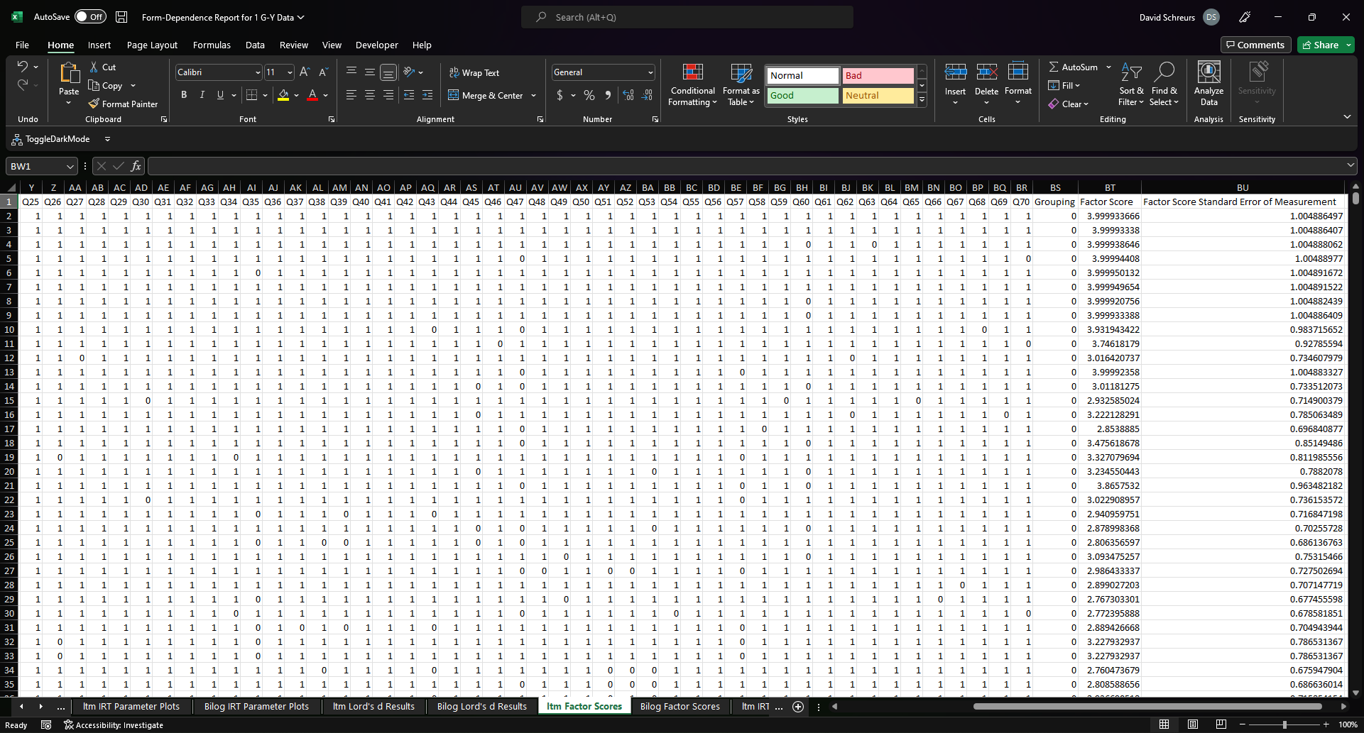
7. Factor Scores
For each student, this table shows the imported responses and the factor scores (and the factor score standard error). Students will be in the same order as the uploaded file. Regardless of engine, these are calculated using a maximum likelihood algorithm.
Which IRT engine you selected will determine which of these tabs (or both) will be present

Slide 41
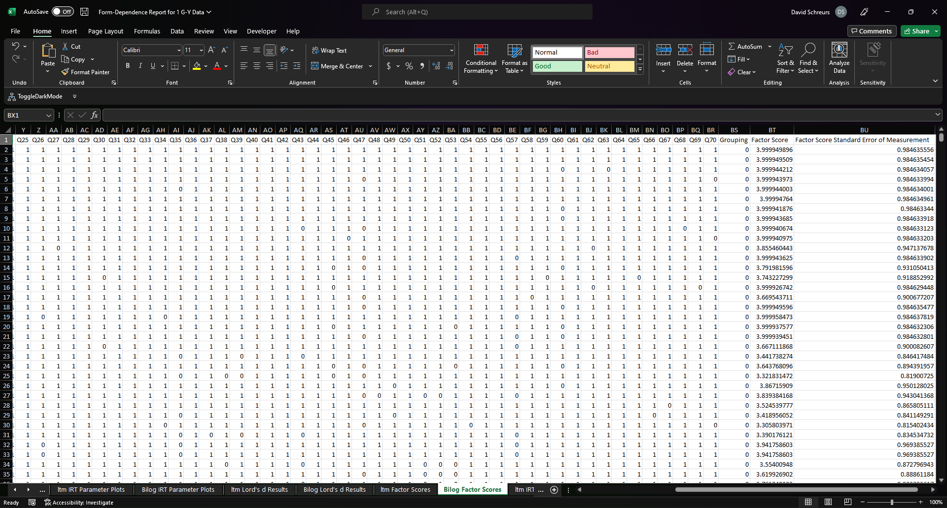
7. Factor Scores
For each student, this table shows the imported responses and the factor scores (and the factor score standard error). Students will be in the same order as the uploaded file. Regardless of engine, these are calculated using a maximum likelihood algorithm.
Which IRT engine you selected will determine which of these tabs (or both) will be present

Slide 42
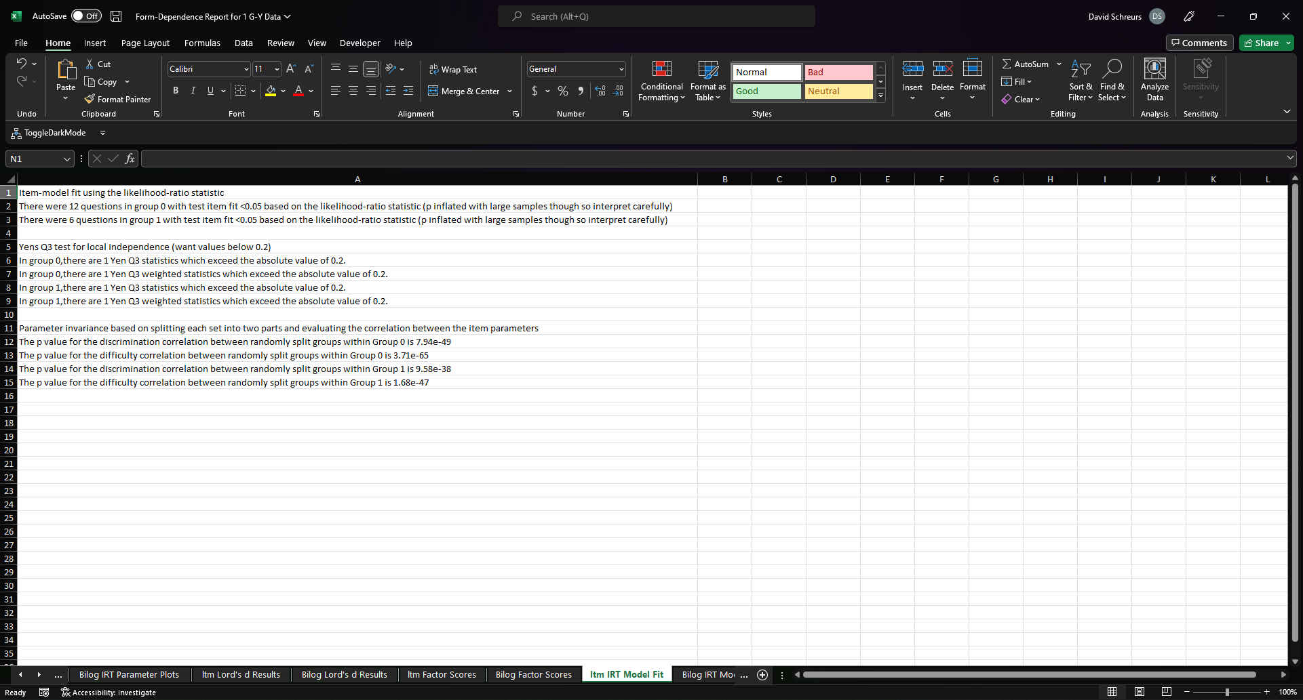
8. IRT Model Fit (*If Selected)
Several fit statistics for the IRT models used to generate the IRT parameters. These are explained further on the last slide.
Which IRT engine you selected will determine which of these tabs (or both) will be present

Slide 43
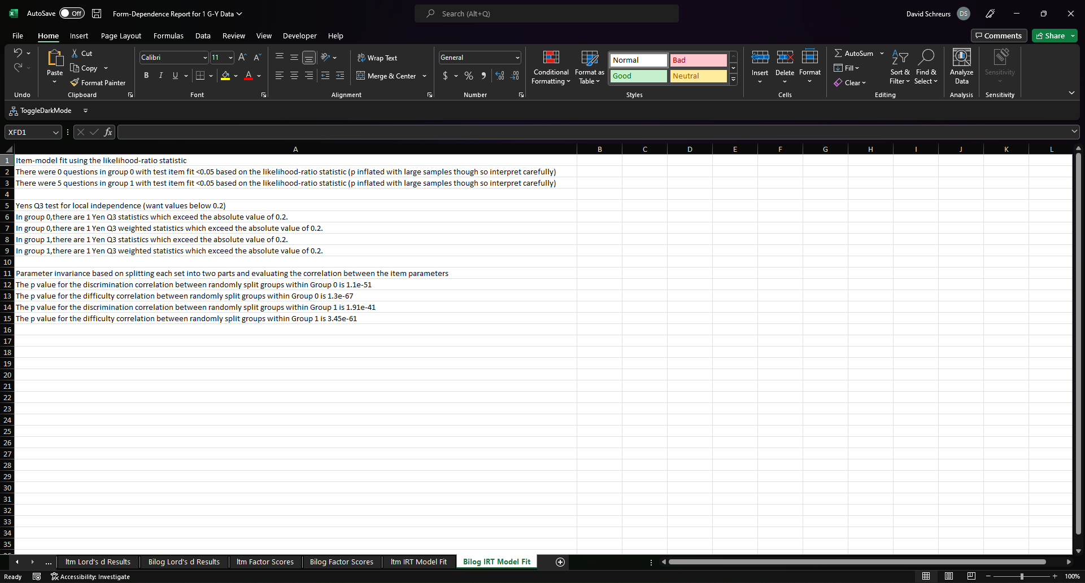
8. IRT Model Fit (*If Selected)
Several fit statistics for the IRT models used to generate the IRT parameters. These are explained further on the last slide.
Which IRT engine you selected will determine which of these tabs (or both) will be present

Slide 44
8. IRT Model Fit (*If Selected)
Item-model fit using the likelihood-ratio statistic
Divides examinees into groups of similar ability and compares the observed proportion of correct answers in each group with the expected proportion under the proposed model. This app uses the “likelihood-ratio statistic” for calculation. Significant items means the item does not fit however as specified in the document, the likelihood of finding significance is dramatically inflated at large sample sizes so interpret liberally.
Yens Q3 test for local independence (want values below 0.2)
IRT assumes local independence (i.e. conditional on the latent trait, item responses are unrelated). This method returns the number of pairs which may violate local independence.
Parameter invariance based on splitting each set into two parts and evaluating the correlation between the item parameters
Test the stability of the parameter estimates by randomly splitting each sample in half, conducting IRT on each of the split samples, and then analyzing the correlation between the two split samples. Higher correlation indicates better parameter stability.

